Slide 1
Statistical Data Science

Slide 2
What is Statistics? What are the types of statistical concepts you should know?
Statistics is one of the popularly known disciplines that is mainly focused on data collection, data organization, data analysis, data interpretation, and data visualization.
Earlier, statistics was practiced by statisticians, economists, business owners to calculate and represent relevant data in their field. Nowadays, statistics has taken a pivotal role in various fields like data science, machine learning, data analyst role, business intelligence analyst role, computer science role, and much more.

Slide 3
Data Analysis
With data analysis, we use two main statistical methods- Descriptive and Inferential.
Descriptive statistics uses tools like mean and standard deviation on a sample to summarize data.
Inferential statistics, on the other hand, looks at data that can randomly vary, and then draw conclusions from it.

Slide 4
Random Data Distribution
What is Data Distribution?
Data Distribution is a list of all possible values, and how often each value occurs.
Such lists are important when working with statistics and data science.
The random module offer methods that returns randomly generated data distributions.
Random Distribution
A random distribution is a set of random numbers that follow a certain probability density function.
Probability Density Function: A function that describes a continuous probability. i.e. probability of all values in an array.
We can generate random numbers based on defined probabilities using the choice() method of the random module.
The choice() method allows us to specify the probability for each value.
The probability is set by a number between 0 and 1, where 0 means that the value will never occur and 1 means that the value will always occur.

Slide 5
Example
Generate a 1-D array containing 100 values, where each value has to be 3, 5, 7 or 9.
The probability for the value to be 3 is set to be 0.1
The probability for the value to be 5 is set to be 0.3
The probability for the value to be 7 is set to be 0.6
The probability for the value to be 9 is set to be 0
from numpy import random x = random.choice([3, 5, 7, 9], p=[0.1, 0.3, 0.6, 0.0], size=(100)) print(x)
The sum of all probability numbers should be 1.
Even if you run the example above 100 times, the value 9 will never occur.
You can return arrays of any shape and size by specifying the shape in the size parameter.

Slide 6
from numpy import random x = random.choice([3, 5, 7, 9], p=[0.1, 0.3, 0.6, 0.0], size=(3, 5)) print(x)

Slide 7
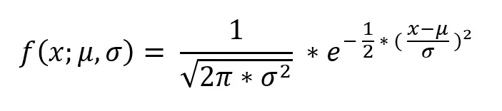
Normal Distribution
A probability distribution is a statistical function that describes the likelihood of obtaining the possible values that a random variable can take. By this, we mean the range of values that a parameter can take when we randomly pick up values from it.
A probability distribution can be discrete or continuous.
Suppose in a city we have heights of adults between the age group of 20-30 years ranging from 4.5 ft. to 7 ft.
If we were asked to pick up 1 adult randomly and asked what his/her (assuming gender does not affect height) height would be? There’s no way to know what the height will be. But if we have the distribution of heights of adults in the city, we can bet on the most probable outcome.
A Normal Distribution is also known as a Gaussian distribution or famously Bell Curve. People use both words interchangeably, but it means the same thing. It is a continuous probability distribution.
The probability density function (pdf) for Normal Distribution:
where, μ = Mean , σ = Standard deviation , x = input value.

Slide 8
import numpy as np import matplotlib.pyplot as plt # Creating a series of data of in range of 1-50. x = np.linspace(1,50,200) #Creating a Function. def normal_dist(x , mean , sd): prob_density = (np.pi*sd) * np.exp(-0.5*((x-mean)/sd)**2) return prob_density #Calculate mean and Standard deviation. mean = np.mean(x) sd = np.std(x) #Apply function to the data. pdf = normal_dist(x,mean,sd) #Plotting the Results plt.plot(x,pdf , color = 'red') plt.xlabel('Data points') plt.ylabel('Probability Density')

Slide 9
Properties of Normal Distribution
The normal distribution density function simply accepts a data point along with a mean value and a standard deviation and throws a value which we call probability density.
We can alter the shape of the bell curve by changing the mean and standard deviation.
Changing the mean will shift the curve towards that mean value, this means we can change the position of the curve by altering the mean value while the shape of the curve remains intact.
The shape of the curve can be controlled by the value of Standard deviation. A smaller standard deviation will result in a closely bounded curve while a high value will result in a more spread out curve.

Slide 10
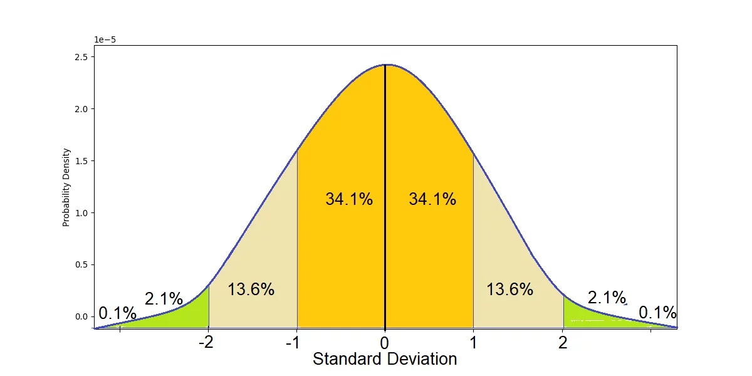
Some excellent properties of a normal distribution:
The mean, mode, and median are all equal.
The total area under the curve is equal to 1.
The curve is symmetric around the mean.
Empirical rule tells us that:
68% of the data falls within one standard deviation of the mean.
95% of the data falls within two standard deviations of the mean.
99.7% of the data falls within three standard deviations of the mean.

Slide 11
Calculating Probabilities with Normal Distribution
To find the probability of a value occurring within a range in a normal distribution, we just need to find the area under the curve in that range. i.e. we need to integrate the density function.
Since the normal distribution is a continuous distribution, the area under the curve represents the probabilities.
Before getting into details first let’s just know what a Standard Normal Distribution is.
A standard normal distribution is just similar to a normal distribution with mean = 0 and standard deviation = 1.
Z = (x-μ)/ σ
The z value above is also known as a z-score. A z-score gives you an idea of how far from the mean a data point is.
If we intend to calculate the probabilities manually we will need to lookup our z-value in a z-table to see the cumulative percentage value.
Python provides us with modules to do this work for us. Let’s get into it.

Slide 12
Creating the Normal Curve
We’ll use scipy.norm class function to calculate probabilities from the normal distribution.
Suppose we have data of the heights of adults in a town and the data follows a normal distribution, we have a sufficient sample size with mean equals 5.3 and the standard deviation is 1.
This information is sufficient to make a normal curve.
data=np.arange(1,10,0.01)
pdf=norm.pdf(data,loc=5.3,scale=1)
sns.set_style("whitegrid")
plt.plot(data,pdf,color="black")
plt.xlabel("Heights")
plt.ylabel("Probabaility Density")

Slide 13
The norm.pdf( ) class method requires loc and scale along with the data as an input argument and gives the probability density value. loc is nothing but the mean and the scale is the standard deviation of data. the code is similar to what we created in the prior section but much shorter.

Slide 14
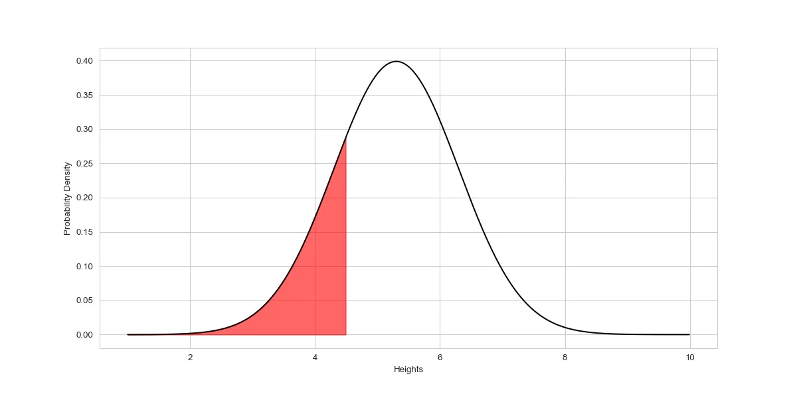
Calculating Probability of Specific Data Occurance
Now, if we were asked to pick one person randomly from this distribution, then what is the probability that the height of the person will be smaller than 4.5 ft. ?
The area under the curve as shown in the figure above will be the probability that the height of the person will be smaller than 4.5 ft if chosen randomly from the distribution. Let’s see how we can calculate this in python.

Slide 15
The area under the curve is nothing but just the Integration of the density function with limits equals -∞ to 4.5.
norm(loc = 5.3 , scale = 1).cdf(4.5)
The single line of code above finds the probability that there is a 21.18% chance that if a person is chosen randomly from the normal distribution with a mean of 5.3 and a standard deviation of 1, then the height of the person will be below 4.5 ft.
We initialize the object of class norm with mean and standard deviation, then using .cdf( ) method passing a value up to which we need to find the cumulative probability value. The cumulative distribution function (CDF) calculates the cumulative probability for a given x-value.
Cumulative probability value from -∞ to ∞ will be equal to 1.
Now, again we were asked to pick one person randomly from this distribution, then what is the probability that the height of the person will be between 6.5 and 4.5 ft. ?

Slide 16
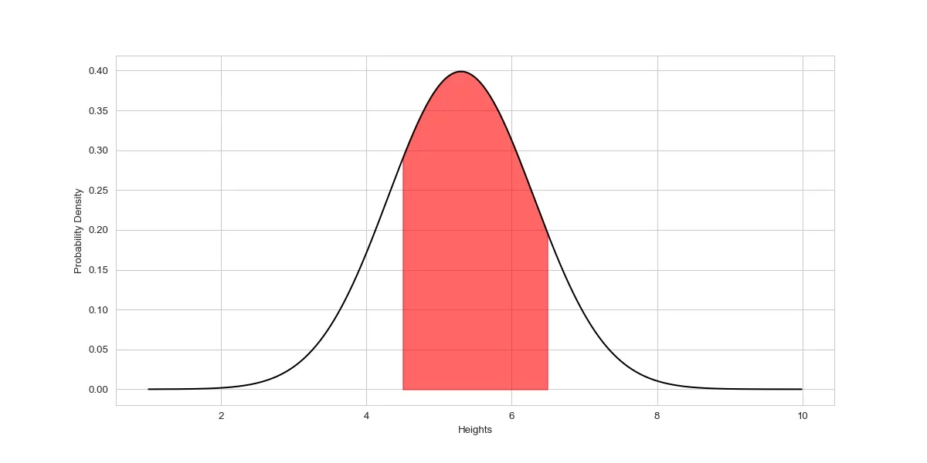
cdf_upper_limit = norm(loc = 5.3 , scale = 1).cdf(6.5)
cdf_lower_limit = norm(loc = 5.3 , scale = 1).cdf(4.5)
prob = cdf_upper_limit - cdf_lower_limit
print(prob)

Slide 17
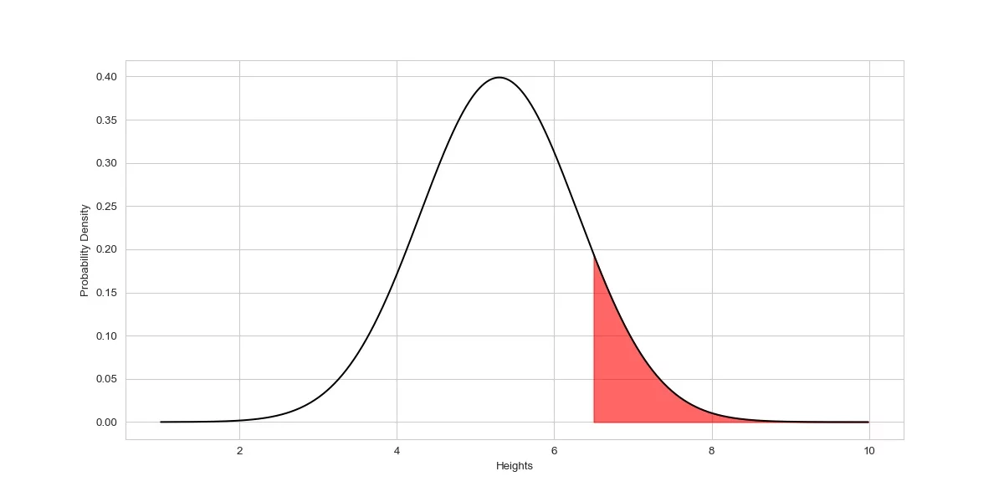
The above code first calculated the cumulative probability value from -∞ to 6.5 and then the cumulative probability value from -∞ to 4.5. if we subtract cdf of 4.5 from cdf of 6.5 the result we get is the area under the curve between the limits 6.5 and 4.5.
Now, what if we were asked about the probability that the height of a person chosen randomly will be above 6.5ft?

Slide 18
It’s simple, as we know the total area under the curve equals 1, and if we calculate the cumulative probability value from -∞ to 6.5 and subtract it from 1, the result will be the probability that the height of a person chosen randomly will be above 6.5ft.
cdf_value = norm(loc = 5.3 , scale = 1).cdf(6.5)
prob = 1- cdf_value
print(prob)

Slide 19
Seaborn
Seaborn is a library that uses Matplotlib underneath to plot graphs. It will be used to visualize random distributions.
Distplots
Distplot stands for distribution plot, it takes as input an array and plots a curve corresponding to the distribution of points in the array.
Plotting a Distplot
import matplotlib.pyplot as plt import seaborn as sns sns.distplot([0, 1, 2, 3, 4, 5]) plt.show()

Slide 20
Plotting a Distplot Without the Histogram
sns.distplot([0, 1, 2, 3, 4, 5], hist=False)

Slide 21
Creating Different Types of Plots
Relational Plots
Relational plots are used for visualizing the statistical relationship between the data points.
Visualization is necessary because it allows the human to see trends and patterns in the data.
Relplot()
data = sns.load_dataset("iris")
# creating the relplot
sns.relplot(x='sepal_width', y='species', data=data)

Slide 22
Categorical Plots
Categorical Plots are used where we have to visualize relationship between two numerical values.
Bar Plot
A barplot is basically used to aggregate the categorical data according to some methods and by default its the mean.
It can also be understood as a visualization of the group by action.
To use this plot we choose a categorical column for the x axis and a numerical column for the y axis and we see that it creates a plot taking a mean per categorical column. It can be created using the barplot() method.
data = sns.load_dataset("iris")
sns.barplot(x='species', y='sepal_length', data=data)

Slide 23
Count Plot
A countplot basically counts the categories and returns a count of their occurrences. It is one of the most simple plots provided by the seaborn library. It can be created using the countplot() method.
data = sns.load_dataset("iris")
sns.countplot(x='species', data=data)

Slide 24
Box Plot
A boxplot is sometimes known as the box and whisker plot.It shows the distribution of the quantitative data that represents the comparisons between variables.
boxplot shows the quartiles of the dataset while the whiskers extend to show the rest of the distribution i.e. the dots indicating the presence of outliers. It is created using the boxplot() method.
data = sns.load_dataset("iris")
sns.boxplot(x='species', y='sepal_width', data=data)

Slide 25
Pairplot
Pairplot represents pairwise relation across the entire dataframe and supports an additional argument called hue for categorical separation.
What it does basically is create a jointplot between every possible numerical column and takes a while if the dataframe is really huge. It is plotted using the pairplot() method.
data = sns.load_dataset("iris")
sns.pairplot(data=data, hue='species')

Slide 26
Normal (Gaussian) Distribution
The Normal Distribution is one of the most important distributions.
It fits the probability distribution of many events, eg. IQ Scores, Heartbeat etc.
Use the random.normal() method to get a Normal Data Distribution.
It has three parameters:
loc - (Mean) where the peak of the bell exists.
scale - (Standard Deviation) how flat the graph distribution should be.
size - The shape of the returned array.

Slide 27
Generate a random normal distribution of size 2x3:
x = random.normal(size=(2, 3))
Generate a random normal distribution of size 2x3 with mean at 1 and standard deviation of 2:
x = random.normal(loc=1, scale=2, size=(2, 3))

Slide 28
Descriptive Statistics
Descriptive statistics is about describing and summarizing data. It uses two main approaches:
The quantitative approach describes and summarizes data numerically.
The visual approach illustrates data with charts, plots, histograms, and other graphs.
You can apply descriptive statistics to one or many datasets or variables. When you describe and summarize a single variable, you’re performing univariate analysis.
When you search for statistical relationships among a pair of variables, you’re doing a bivariate analysis.
Similarly, a multivariate analysis is concerned with multiple variables at once.

Slide 29
Types of Measures
Central tendency tells you about the centers of the data. Useful measures include the mean, median, and mode.
Variability tells you about the spread of the data. Useful measures include variance and standard deviation.
Correlation or joint variability tells you about the relation between a pair of variables in a dataset. Useful measures include covariance and the correlation coefficient.

Slide 30
Population and Samples
In statistics, the population is a set of all elements or items that you’re interested in.
Populations are often vast, which makes them inappropriate for collecting and analyzing data. That’s why statisticians usually try to make some conclusions about a population by choosing and examining a representative subset of that population.
This subset of a population is called a sample. Ideally, the sample should preserve the essential statistical features of the population to a satisfactory extent. That way, you’ll be able to use the sample to glean conclusions about the population.

Slide 31
Outliers
An outlier is a data point that differs significantly from the majority of the data taken from a sample or population. There are many possible causes of outliers, but here are a few to start you off:
Natural variation in data
Change in the behavior of the observed system
Errors in data collection
Data collection errors are a particularly prominent cause of outliers. For example, the limitations of measurement instruments or procedures can mean that the correct data is simply not obtainable. Other errors can be caused by miscalculations, data contamination, human error, and more.

Slide 32
Measures of Central Tendency
The measures of central tendency show the central or middle values of datasets.
Mean
The sample mean, also called the sample arithmetic mean or simply the average, is the arithmetic average of all the items in a dataset. The mean of a dataset 𝑥 is mathematically expressed as Σᵢ𝑥ᵢ/𝑛, where 𝑖 = 1, 2, …, 𝑛. In other words, it’s the sum of all the elements 𝑥ᵢ divided by the number of items in the dataset 𝑥.

Slide 33
Median
The median is a type of average value, which describes where the center of the data is located.
The median is the middle value in a data set ordered from low to high.
Mode
The mode is a type of average value, which describes where most of the data is located.
The mode is the value(s) that are the most common in the data.
A distribution of values with only one mode is called unimodal.
A distribution of values with two modes is called bimodal. In general, a distribution with more than one mode is called multimodal.
Mode can be found for both categorical and numerical data.

Slide 34
Finding the Mode
from statistics import multimode values = [4,7,3,8,11,7,10,19,6,9,12,12] x = multimode(values)

Slide 35
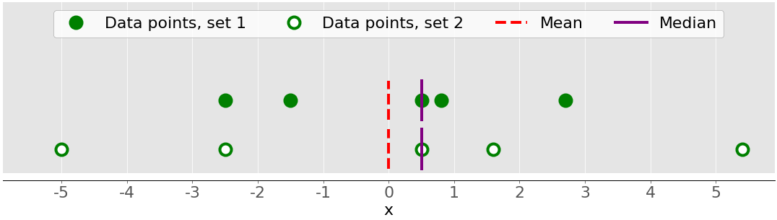
Measures of Variability
The measures of central tendency aren’t sufficient to describe data.
You’ll also need the measures of variability that quantify the spread of data points.
Variance
The sample variance quantifies the spread of the data. It shows numerically how far the data points are from the mean. You can express the sample variance of the dataset 𝑥 with 𝑛 elements mathematically as 𝑠² = Σᵢ(𝑥ᵢ − mean(𝑥))² / (𝑛 − 1), where 𝑖 = 1, 2, …, 𝑛 and mean(𝑥) is the sample mean of 𝑥.
The following figure shows you why it’s important to consider the variance when describing datasets:
There are two datasets in this figure:
Green dots: This dataset has a smaller variance or a smaller average difference from the mean. It also has a smaller range or a smaller difference between the largest and smallest item.
White dots: This dataset has a larger variance or a larger average difference from the mean. It also has a bigger range or a bigger difference between the largest and smallest item.

Slide 36
Note that these two datasets have the same mean and median, even though they appear to differ significantly. Neither the mean nor the median can describe this difference. That’s why you need the measures of variability.
var_ = statistics.variance(x)
Standard Deviation
The sample standard deviation is another measure of data spread. It’s connected to the sample variance, as standard deviation, 𝑠, is the positive square root of the sample variance.
The standard deviation is often more convenient than the variance because it has the same unit as the data points.
std_ = statistics.stdev(x)
The population standard deviation refers to the entire population.

Slide 37
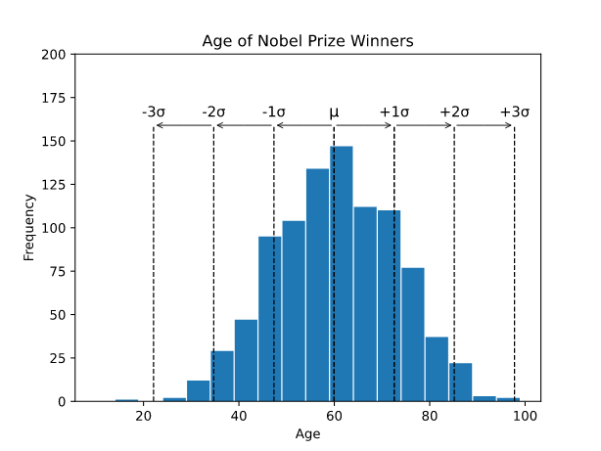
Standard Deviation
Standard deviation (σ) measures how far a 'typical' observation is from the average of the data (μ).
Standard deviation is important for many statistical methods.
Here is a histogram of the age of all 934 Nobel Prize winners up to the year 2020, showing standard deviations:
Each dotted line in the histogram shows a shift of one extra standard deviation.

Slide 38
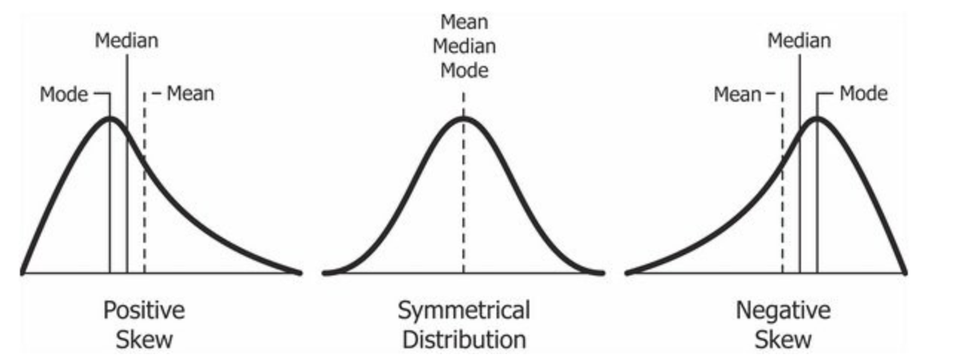
Skewness
The sample skewness measures the asymmetry of a data sample.
In simple words, skewness is the measure of how much the probability distribution of a random variable deviates from the normal distribution.
the normal distribution is the probability distribution without any skewness.
You can look at the image below which shows symmetrical distribution that’s basically a normal distribution and you can see that it is symmetrical on both sides of the dashed line. Apart from this, there are two types of skewness:
Print(df.skew())
Positive Skewness
Negative Skewness

Slide 39

Understanding Positively Skewed Distribution
A positively skewed distribution is the distribution with the tail on its right side. The value of skewness for a positively skewed distribution is greater than zero.
As you might have already understood by looking at the figure, the value of mean is the greatest one followed by median and then by mode.
So why is this happening?
Well, the answer to that is that the skewness of the distribution is on the right; it causes the mean to be greater than the median and eventually move to the right
Also, the mode occurs at the highest frequency of the distribution which is on the left side of the median. Therefore, mode < median < mean.
In the above boxplot, you can see that Q2 is present nearer to Q1. This represents a positively skewed distribution. In terms of quartiles, it can be given by:

Slide 40

In this case, it was very easy to tell if the data is skewed or not. But what if we have something like this:
Here, Q2-Q1 and Q3-Q2 are equal and yet the distribution is positively skewed.
the length of the right whisker is greater than the left whisker. From this, we can conclude that the data is positively skewed.
So, the first step is always to check the equality of Q2-Q1 and Q3-Q2. If that is found equal, then we look for the length of whiskers.

Slide 41

Understanding Negatively Skewed Distribution
The value of skewness for a negatively skewed distribution is less than zero. You can also see in the above figure that the mean < median < mode.

Slide 42
If the skewness is between -0.5 and 0.5, the data are fairly symmetrical
If the skewness is between -1 and — 0.5 or between 0.5 and 1, the data are moderately skewed
If the skewness is less than -1 or greater than 1, the data are highly skewed
dataVal=[(10,20,30,40,50,60,70),(10,10,40,40,50,60,70),(10,20,30,50,50,60,80)]
df=pd.DataFrame(dataVal)
skewValue=df.skew(axis=1)
Observations:
· A skewness value of 0 in the output denotes a symmetrical distribution of values in row 1.
A negative skewness value in the output indicates an asymmetry in the distribution corresponding to row 2 and the tail is larger towards the left hand side of the distribution.
A positive skewness value in the output indicates an asymmetry in the distribution corresponding to row 3 and the tail is larger towards the right hand side of the distribution

Slide 43
Kurtosis
Kurtosis is one of the two measures that quantify shape of a distribution. kutosis determine the volume of the outlier
Kurtosis describes the peakedness of the distribution.
If the distribution is tall and thin it is called a leptokurtic distribution(Kurtosis > 3). Values in a leptokurtic distribution are near the mean or at the extremes.
A flat distribution where the values are moderately spread out (i.e., unlike leptokurtic) is called platykurtic(Kurtosis <3) distribution.
A distribution whose shape is in between a leptokurtic distribution and a platykurtic distribution is called a mesokurtic(Kurtosis=3) distribution. A mesokurtic distribution looks more close to a normal distribution.
Kurtosis is sometimes reported as “excess kurtosis.” Excess kurtosis is determined by subtracting 3 from the kurtosis. This makes the normal distribution kurtosis equal 0.

Slide 44
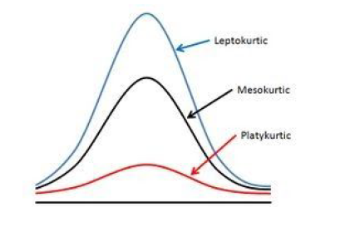
High kurtosis in a data set is an indicator that data has heavy outliers.
Low kurtosis in a data set is an indicator that data has lack of outliers.
If kurtosis value + means pointy and — means flat.

Slide 45
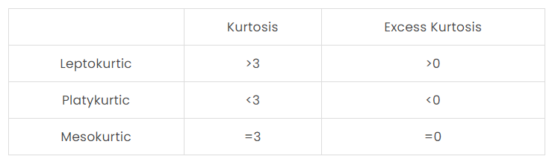
Leptokurtic: Leptokurtic is a curve having a high peak than the normal distribution. In this curve, there is too much concentration of items near the central value.
Mesokurtic: Mesokurtic is a curve having a normal peak than the normal curve. In this curve, there is equal distribution of items around the central value.
Platykurtic: Platykurtic is a curve having a low peak than the normal curve is called platykurtic. In this curve, there is less concentration of items around the central value.
Kurtosis can take several values:

Slide 46
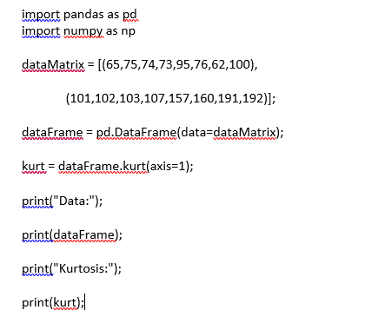
Kurtosis function in pandas:
The pandas DataFrame has a computing method kurtosis() which computes the kurtosis for a set of values across a specific axis (i.e., a row or a column).

Slide 47

Quartiles and Percentiles
Quartiles and percentiles are a measures of variation, which describes how spread out the data is.
Quartiles and percentiles are both types of quantiles.
Quartiles are values that separate the data into four equal parts.
Here is a histogram of the age of all 934 Nobel Prize winners up to the year 2020, showing the quartiles:
The quartiles (Q₀,Q₁,Q₂,Q₃,Q₄) are the values that separate each quarter.
Between Q₀ and Q₁ are the 25% lowest values in the data. Between Q₁ and Q₂ are the next 25%. And so on.
Q₀ is the smallest value in the data.
Q₁ is the value separating the first quarter from the second quarter of the data.
Q₂ is the middle value (median), separating the bottom from the top half.
Q₃ is the value separating the third quarter from the fourth quarter
Q₄ is the largest value in the data.

Slide 48
Calculating Quartiles
With Python use the NumPy library quantile() method to find the quartiles of the values 13, 21, 21, 40, 42, 48, 55, 72:
values = [13,21,21,40,42,48,55,72] x = numpy.quantile(values, [0,0.25,0.5,0.75,1])

Slide 49
Percentiles
Percentiles are values that separate the data into 100 equal parts.
For example, The 95th percentile separates the lowest 95% of the values from the top 5%
The 25th percentile (P_{25%}) is the same as the first quartile (Q₁).
The 50th percentile (P_{50%}) is the same as the second quartile (Q₂) and the median.
The 75th percentile (P_{75%}) is the same as the third quartile (Q₃)

Slide 50
Calculating Percentiles
With Python use the NumPy library percentile() method to find the 65th percentile of the values 13, 21, 21, 40, 42, 48, 55, 72:
values = [13,21,21,40,42,48,55,72] x = numpy.percentile(values, 65)

Slide 51

Interquartile Range
Interquartile range is the difference between the first and third quartiles (Q₁ and Q₃).
The 'middle half' of the data is between the first and third quartile.
The first quartile is the value in the data that separates the bottom 25% of values from the top 75%.
The third quartile is the value in the data that separates the bottom 75% of the values from the top 25%
Here is a histogram of the age of all 934 Nobel Prize winners up to the year 2020, showing the interquartile range (IQR):
Here, the middle half of is between 51 and 69 years. The interquartile range for Nobel Prize winners is then 18 years.

Slide 52
Calculating the Interquartile Range
With Python use the SciPy library iqr() method to find the interquartile range of the values 13, 21, 21, 40, 42, 48, 55, 72:
from scipy import stats values = [13,21,21,40,42,48,55,72] x = stats.iqr(values)

Slide 53
INFERENTIAL STATISTICS
Inferential statistics are used to draw inferences from the sample of a huge data set. Random samples of data are taken from a population, which are then used to describe and make inferences and predictions about the population.

Slide 54
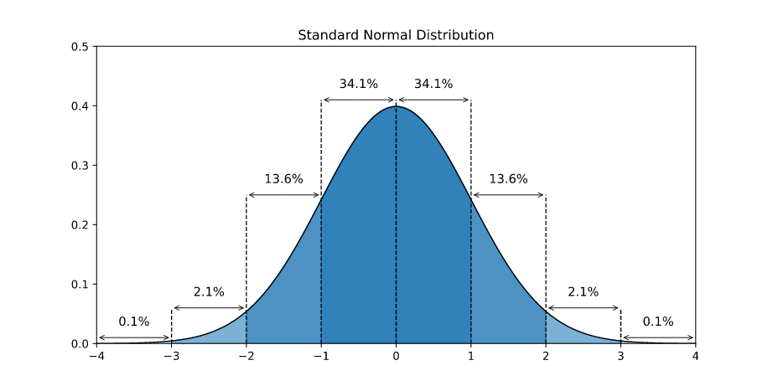
Standard Normal Distribution
The standard normal distribution is a normal distribution where the mean is 0 and the standard deviation is 1.
Normally distributed data can be transformed into a standard normal distribution.
Standardizing normally distributed data makes it easier to compare different sets of data.
The standard normal distribution is used for:
Calculating confidence intervals
Hypothesis tests
Here is a graph of the standard normal distribution with probability values (p-values) between the standard deviations:

Slide 55
Standardizing makes it easier to calculate probabilities.
The functions for calculating probabilities are complex and difficult to calculate by hand.
Typically, probabilities are found by looking up tables of pre-calculated values, or by using software and programming.
The standard normal distribution is also called the 'Z-distribution' and the values are called 'Z-values' (or Z-scores).
Z-Values
Z-values express how many standard deviations from the mean a value is.
The formula for calculating a Z-value is:
Z=X-mean/s.d
For example, if we know that:
The mean height of people in Germany is 170 cm (μ)
The standard deviation of the height of people in Germany is 10 cm (σ)
Bob is 200 cm tall (x)
Bob is 30 cm taller than the average person in Germany.
30 cm is 3 times 10 cm. So Bob's height is 3 standard deviations larger than mean height in Germany.

Slide 56
Using the formula:
Z=200-170/10=3
The Z-value of Bob's height (200 cm) is 3.
Using a Z-table or programming we can calculate how many people Germany are shorter than Bob and how many are taller.
With Python use the Scipy Stats library norm.cdf() function find the probability of getting less than a Z-value of 3:
import scipy.stats as stats print(stats.norm.cdf(3))
Which means that Bob is taller than 99.87% of the people in Germany.

Slide 57
Parameters and Statistics
The terms 'parameter' and (sample) 'statistic' refer to key concepts that are closely related in statistics.
They are also directly connected to the concepts of populations and samples.
Parameter: A number that describes something about the whole population.
Sample statistic: A number that describes something about the sample.
The parameters are the key things we want to learn about. The parameters are usually unknown.
Sample statistics gives us estimates for parameters.
There will always be some uncertainty about how accurate estimates are. More certainty gives us more useful knowledge.
For every parameter we want to learn about we can get a sample and calculate a sample statistic, which gives us an estimate of the parameter.
Some Important Examples
Parameter Sample statistic
Mean Sample mean
Median Sample median
Mode Sample mode
Variance Sample variance
Standard deviation Sample standard deviation

Slide 58
Mean, median and mode are different types of averages (typical values in a population).
For example:
The typical age of people in a country
The typical profits of a company
The typical range of an electric car
Variance and standard deviation are two types of values describing how spread out the values are.
A single class of students in a school would usually be about the same age. The age of the students will have low variance and standard deviation.
A whole country will have people of all kinds of different ages. The variance and standard deviation of age in the whole country would then be bigger than in a single school grade.

Slide 59
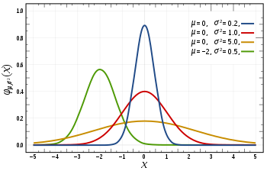
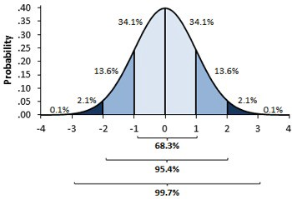
Hypothesis testing
Hypothesis testing is a statistical method that is used in making statistical decisions using experimental data. Hypothesis Testing is basically an assumption that we make about the population parameter.
Ex : you say avg student in class is 40 or a boy is taller than girls.
all those example we assume need some statistic way to prove those. we need some mathematical conclusion what ever we are assuming is true.
why do we use it ?
Hypothesis testing is an essential procedure in statistics. A hypothesis test evaluates two mutually exclusive statements about a population to determine which statement is best supported by the sample data.
When we say that a finding is statistically significant, it’s thanks to a hypothesis test.
what are basic of hypothesis ?
The basic of hypothesis is normalisation and standard normalisation. all our hypothesis is revolve around basic of these 2 terms. let’s see these.

Slide 60
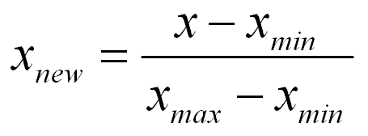

You must be wondering what’s difference between these two image
in 1st first you can see there are different normal curve all those normal curve can have different mean’s and variances where as in 2nd image if you notice the graph is properly distributed and mean =0 and variance =1 always. concept of z-score comes in picture when we use standardised normal data.
Normal Distribution –
A variable is said to be normally distributed or have a normal distribution if its distribution has the shape of a normal curve — a special bell-shaped curve. … The graph of a normal distribution is called the normal curve, which has all of the following properties: 1. The mean, median, and mode are equal.
Standardised Normal Distribution
A standard normal distribution is a normal distribution with mean 0 and standard deviation 1

Slide 61
Which are important parameter of hypothesis testing ?
Null hypothesis :- In inferential statistics, the null hypothesis is a general statement or default position that there is no relationship between two measured phenomena, or no association among groups
In other words it is a basic assumption or made based on domain or problem knowledge.
Example : a company production is = 50 unit/per day etc.
Alternative hypothesis :-
The alternative hypothesis is the hypothesis used in hypothesis testing that is contrary to the null hypothesis. It is usually taken to be that the observations are the result of a real effect (with some amount of chance variation superposed)
Example : a company production is !=50 unit/per day etc.

Slide 62
Level of significance:
Refers to the degree of significance in which we accept or reject the null-hypothesis. 100% accuracy is not possible for accepting or rejecting a hypothesis, so we therefore select a level of significance that is usually 5%.
This is normally denoted with alpha(maths symbol ) and generally it is 0.05 or 5% , which means your output should be 95% confident to give similar kind of result in each sample.
Type I error:When we reject the null hypothesis, although that hypothesis was true. Type I error is denoted by alpha. In hypothesis testing, the normal curve that shows the critical region is called the alpha region
Type II errors: When we accept the null hypothesis but it is false. Type II errors are denoted by beta. In Hypothesis testing, the normal curve that shows the acceptance region is called the beta region.
One tailed test :-A test of a statistical hypothesis , where the region of rejection is on only one side of the sampling distribution , is called a one-tailed test.
Example :- a college has ≥ 4000 student or data science ≤ 80% org adopted.
Two-tailed test :- A two-tailed test is a statistical test in which the critical area of a distribution is two-sided and tests whether a sample is greater than or less than a certain range of values. If the sample being tested falls into either of the critical areas, the alternative hypothesis is accepted instead of the null hypothesis.
Example : a college != 4000 student or data science != 80% org adopted

Slide 63
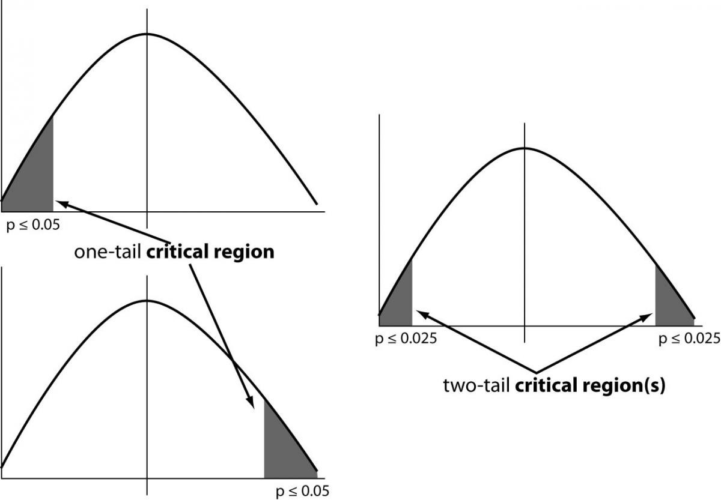

Slide 64
P-value
The P value, or calculated probability, is the probability of finding the observed, or more extreme, results when the null hypothesis (H 0) of a study question is true — the definition of ‘extreme’ depends on how the hypothesis is being tested.
If your P value is less than the chosen significance level then you reject the null hypothesis i.e. accept that your sample gives reasonable evidence to support the alternative hypothesis. It does NOT imply a “meaningful” or “important” difference; that is for you to decide when considering the real-world relevance of your result.
Example : you have a coin and you don’t know whether that is fair or tricky so let’s decide null and alternate hypothesis
H0 : a coin is a fair coin.
H1 : a coin is a tricky coin. and alpha = 5% or 0.05
Now let’s toss the coin and calculate p- value ( probability value)
Toss a coin 1st time and result is tail- P-value = 50% (as head and tail have equal probability)
Toss a coin 2nd time and result is tail, now p-value = 50/2 = 25%
and similarly we Toss 6 consecutive time and got result as P-value = 1.5% but we set our significance level as 95% means 5% error rate we allow and here we see we are beyond that level i.e. our null- hypothesis does not hold good so we need to reject and propose that this coin is a tricky coin which is actually.

Slide 65
hypothesis testing type
T Test ( Student T test)
A t-test is a type of inferential statistic which is used to determine if there is a significant difference between the means of two groups which may be related in certain features.
It is mostly used when the data sets, like the set of data recorded as outcome from flipping a coin a 100 times, would follow a normal distribution and may have unknown variances.
T test is used as a hypothesis testing tool, which allows testing of an assumption applicable to a population.
T-test has 2 types : 1. one sampled t-test 2. two-sampled t-test.
One sample t-test : The One Sample t Test determines whether the sample mean is statistically different from a known or hypothesised population mean. The One Sample t Test is a parametric test.
Example :- you have 10 ages and you are checking whether avg age is 30 or not.

Slide 66
from scipy.stats import ttest_1samp
import numpy as np
ages = [20,30,25,30,45,12,34,40,40,35]
print(ages)
ages_mean = np.mean(ages)
print(ages_mean)
tset, pval = ttest_1samp(ages, 30)
print(“p-values”,pval)
if pval < 0.05: # alpha value is 0.05 or 5%
print(" we are rejecting null hypothesis")
else:
print("we are accepting null hypothesis")

Slide 67
Two sampled T-test
The Independent Samples t Test or 2-sample t-test compares the means of two independent groups in order to determine whether there is statistical evidence that the associated population means are significantly different.
The Independent Samples t Test is a parametric test. This test is also known as: Independent t Test.
Example : is there any association between week1 and week2

Slide 68
Paired sampled t-test
The paired sample t-test is also called dependent sample t-test. It’s an uni variate test that tests for a significant difference between 2 related variables.
An example of this is if you where to collect the blood pressure for an individual before and after some treatment, condition, or time point.
H0 :- means difference between two sample is 0
H1:- mean difference between two sample is not 0
import pandas as pd
from scipy import stats
df = pd.read_csv("blood_pressure.csv")
df[['bp_before','bp_after']].describe()
ttest,pval = stats.ttest_rel(df['bp_before'], df['bp_after'])
print(pval)
if pval<0.05:
print("reject null hypothesis")
else:
print("accept null hypothesis")

Slide 69
When you can run a Z Test.
You would use a Z test if:
Your sample size is greater than 30. Otherwise, use a t test.
Data points should be independent from each other. In other words, one data point isn’t related or doesn’t affect another data point.
Your data should be normally distributed. However, for large sample sizes (over 30) this doesn’t always matter.
Your data should be randomly selected from a population, where each item has an equal chance of being selected.
Sample sizes should be equal if at all possible.
Example again we are using z-test for blood pressure with some mean like 156

Slide 70
one-sample Z test.
import pandas as pd
from scipy import stats
from statsmodels.stats import weightstats as stests
ztest ,pval = stests.ztest(df['bp_before'], x2=None, value=156)
print(float(pval))
if pval<0.05:
print("reject null hypothesis")
else:
print("accept null hypothesis")

Slide 71
Two-sample Z test
In two sample z-test , similar to t-test here we are checking two independent data groups and deciding whether sample mean of two group is equal or not.
H0 : mean of two group is 0
H1 : mean of two group is not 0
Example : we are checking in blood data after blood and before blood data.
ztest ,pval1 = stests.ztest(df['bp_before'], x2=df['bp_after'], value=0,alternative='two-sided')
print(float(pval1))
if pval<0.05:
print("reject null hypothesis")
else:
print("accept null hypothesis")

Slide 72
ANOVA (F-TEST)
The t-test works well when dealing with two groups, but sometimes we want to compare more than two groups at the same time.
For example, if we wanted to test whether voter age differs based on some categorical variable like race, we have to compare the means of each level or group the variable.
We could carry out a separate t-test for each pair of groups, but when you conduct many tests you increase the chances of false positives.
The analysis of variance or ANOVA is a statistical inference test that lets you compare multiple groups at the same time.
F = Between group variability / Within group variability
Unlike the z and t-distributions, the F-distribution does not have any negative values because between and within-group variability are always positive due to squaring each deviation.
One Way F-test(Anova) :- It tell whether two or more groups are similar or not based on their mean similarity and f-score.
Example : there are 3 different category of plant and their weight and need to check whether all 3 group are similar or not

Slide 73
df_anova = pd.read_csv('PlantGrowth.csv') df_anova = df_anova[['weight','group']]grps = pd.unique(df_anova.group.values) d_data = {grp:df_anova['weight'][df_anova.group == grp] for grp in grps} F, p = stats.f_oneway(d_data['ctrl'], d_data['trt1'], d_data['trt2'])print("p-value for significance is: ", p)if p<0.05: print("reject null hypothesis") else: print("accept null hypothesis")

Slide 74
Two Way F-test
A two-way ANOVA is used to determine whether or not there is a statistically significant difference between the means of three or more independent groups that have been split on two factors.
The purpose of a two-way ANOVA is to determine how two factors impact a response variable, and to determine whether or not there is an interaction between the two factors on the response variable.
A botanist wants to know whether or not plant growth is influenced by sunlight exposure and watering frequency.
She plants 30 seeds and lets them grow for two months under different conditions for sunlight exposure and watering frequency. After two months, she records the height of each plant, in inches.
Use the following steps to perform a two-way ANOVA to determine if watering frequency and sunlight exposure have a significant effect on plant growth, and to determine if there is any interaction effect between watering frequency and sunlight exposure.
Step 1: Enter the data.
First, we’ll create a pandas DataFrame that contains the following three variables:
water: how frequently each plant was watered: daily or weekly
sun: how much sunlight exposure each plant received: low, medium, or high
height: the height of each plant (in inches) after two months

Slide 75
df = pd.DataFrame({'water': np.repeat(['daily', 'weekly'], 15),
'sun': np.tile(np.repeat(['low', 'med', 'high'], 5), 2),
'height': [6, 6, 6, 5, 6, 5, 5, 6, 4, 5,
6, 6, 7, 8, 7, 3, 4, 4, 4, 5,
4, 4, 4, 4, 4, 5, 6, 6, 7, 8]})
Step 2: Perform the two-way ANOVA.

Slide 76
Univariate Analysis
The term univariate analysis refers to the analysis of one variable. You can remember this because the prefix “uni” means “one.”
There are three common ways to perform univariate analysis on one variable:
1. Summary statistics – Measures the center and spread of values.
2. Frequency table – Describes how often different values occur.
3. Charts – Used to visualize the distribution of values.
import pandas as pd
#create DataFrame
df = pd.DataFrame({'points': [1, 1, 2, 3.5, 4, 4, 4, 5, 5, 6.5, 7, 7.4, 8, 13, 14.2],
'assists': [5, 7, 7, 9, 12, 9, 9, 4, 6, 8, 8, 9, 3, 2, 6],
'rebounds': [11, 8, 10, 6, 6, 5, 9, 12, 6, 6, 7, 8, 7, 9, 15]})
#view first five rows of DataFrame
df.head()

Slide 77
1. Calculate Summary Statistics
We can use the following syntax to calculate various summary statistics for the ‘points’ variable in the DataFrame:
#calculate mean of 'points'
df['points'].mean()
#calculate median of 'points'
df['points'].median()
#calculate standard deviation of 'points'
df['points'].std()

Slide 78
2. Create Frequency Table
#create frequency table for 'points'
df['points'].value_counts()
This tells us that:
The value 4 occurs 3 times
The value 1 occurs 2 times
The value 5 occurs 2 times
The value 2 occurs 1 time

Slide 79
3. Create Charts
import matplotlib.pyplot as plt
df.boxplot(column=['points'], grid=False, color='black’)
We can use the following syntax to create a histogram for the ‘points’ variable:
df.hist(column='points', grid=False, edgecolor='black’)
We can use the following syntax to create a density curve for the ‘points’ variable:
sns.kdeplot(df['points'])

Slide 80
Bivariate Analysis
The term bivariate analysis refers to the analysis of two variables. You can remember this because the prefix “bi” means “two.”
The purpose of bivariate analysis is to understand the relationship between two variables
There are three common ways to perform bivariate analysis:
1. Scatterplots
2. Correlation Coefficients
3. Simple Linear Regression

Slide 81
The following example shows how to perform each of these types of bivariate analysis in Python using the following pandas DataFrame that contains information about two variables: (1) Hours spent studying and (2) Exam score received by 20 different students:
df = pd.DataFrame({'hours': [1, 1, 1, 2, 2, 2, 3, 3, 3, 3,
3, 4, 4, 5, 5, 6, 6, 6, 7, 8],
'score': [75, 66, 68, 74, 78, 72, 85, 82, 90, 82,
80, 88, 85, 90, 92, 94, 94, 88, 91, 96]})

Slide 82
1. Scatterplots
We can use the following syntax to create a scatterplot of hours studied vs. exam score:
plt.scatter(df.hours, df.score)
plt.title('Hours Studied vs. Exam Score')
plt.xlabel('Hours Studied')
plt.ylabel('Exam Score’)
The x-axis shows the hours studied and the y-axis shows the exam score received.
From the plot we can see that there is a positive relationship between the two variables: As hours studied increases, exam score tends to increase as well.

Slide 83
2. Correlation Coefficients
A Pearson Correlation Coefficient is a way to quantify the linear relationship between two variables.
We can use the corr() function in pandas to create a correlation matrix:
df.corr()
The correlation coefficient turns out to be 0.891. This indicates a strong positive correlation between hours studied and exam score received.

Slide 84
3. Simple Linear Regression
Simple linear regression is a statistical method we can use to quantify the relationship between two variables.
We can use the OLS() function from the statsmodels package to quickly fit a simple linear regression model for hours studied and exam score received:
import statsmodels.api as sm
#define response variable
y = df['score']
#define explanatory variable
x = df[['hours']]
#add constant to predictor variables
x = sm.add_constant(x)
#fit linear regression model
model = sm.OLS(y, x).fit()
print(model.summary())

Slide 85
The fitted regression equation turns out to be:
Exam Score = 69.0734 + 3.8471*(hours studied)
This tells us that each additional hour studied is associated with an average increase of 3.8471 in exam score.
We can also use the fitted regression equation to predict the score that a student will receive based on their total hours studied.
For example, a student who studies for 3 hours is predicted to receive a score of 81.6147:
Exam Score = 69.0734 + 3.8471*(hours studied)
Exam Score = 69.0734 + 3.8471*(3)
Exam Score = 81.6147

Slide 86
The Significance Level
The significance level (α) is the uncertainty we accept when rejecting the null hypothesis in the hypothesis test.
The significance level is a percentage probability of accidentally making the wrong conclusion.
Typical significance levels are:
α=0.1 (10%)
α=0.05 (5%)
α=0.01 (1%)
A lower significance level means that the evidence in the data needs to be stronger to reject the null hypothesis.
There is no "correct" significance level - it only states the uncertainty of the conclusion
Note: A 5% significance level means that when we reject a null hypothesis:
We expect to reject a true null hypothesis 5 out of 100 times.

Slide 87
The Test Statistic
The test statistic is used to decide the outcome of the hypothesis test.
The test statistic is a standardized value calculated from the sample.
Standardization means converting a statistic to a well known probability distribution.
The type of probability distribution depends on the type of test.
Common examples are:
Standard Normal Distribution (Z): used for Testing Population Proportions
Student's T-Distribution (T): used for Testing Population Means

Slide 88
The Critical Value and P-Value Approach
There are two main approaches used for hypothesis tests:
The critical value approach compares the test statistic with the critical value of the significance level.
The p-value approach compares the p-value of the test statistic and with the significance level.

Slide 89
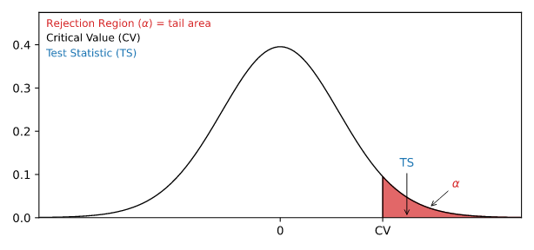
The Critical Value Approach
The critical value approach checks if the test statistic is in the rejection region.
The rejection region is an area of probability in the tails of the distribution.
The size of the rejection region is decided by the significance level (α).
The value that separates the rejection region from the rest is called the critical value.
Here is a graphical illustration:
If the test statistic is inside this rejection region, the null hypothesis is rejected.
For example, if the test statistic is 2.3 and the critical value is 2 for a significance level (α=0.05):
We reject the null hypothesis (H0) at 0.05 significance level (α)

Slide 90
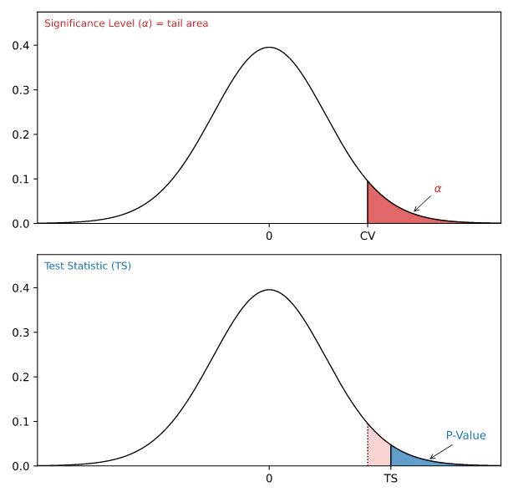
The P-Value Approach
The p-value approach checks if the p-value of the test statistic is smaller than the significance level (α).
The p-value of the test statistic is the area of probability in the tails of the distribution from the value of the test statistic.
If the p-value is smaller than the significance level, the null hypothesis is rejected.
The p-value directly tells us the lowest significance level where we can reject the null hypothesis.
For example, if the p-value is 0.03:
We reject the null hypothesis (H0) at a 0.05 significance level (α)
We keep the null hypothesis (H0) at a 0.01 significance level (α)

Slide 91
Steps for a Hypothesis Test
The following steps are used for a hypothesis test:
Check the conditions
Define the claims
Decide the significance level
Calculate the test statistic
Conclusion
One condition is that the sample is randomly selected from the population.
The other conditions depends on what type of parameter you are testing the hypothesis for.
Common parameters to test hypotheses are:
Proportions (for qualitative data)
Mean values (for numerical data)

Slide 92
Hypothesis Testing a Proportion
A population proportion is the share of a population that belongs to a particular category.
Hypothesis tests are used to check a claim about the size of that population proportion.
For example:
Population: Nobel Prize winners
Category: Born in the United States of America
And we want to check the claim:
"More than 20% of Nobel Prize winners were born in the US“
By taking a sample of 40 randomly selected Nobel Prize winners we could find that:
10 out of 40 Nobel Prize winners in the sample were born in the US
The sample proportion is then: 10/40=0.25, or 25%.
From this sample data we check the claim with the steps below.

Slide 93
Checking the Conditions
The conditions for calculating a confidence interval for a proportion are:
The sample is randomly selected
There is only two options:
Being in the category
Not being in the category
The sample needs at least:
5 members in the category
5 members not in the category
In our example, we randomly selected 10 people that were born in the US.
The rest were not born in the US, so there are 30 in the other category.
The conditions are fulfilled in this case.
Note: It is possible to do a hypothesis test without having 5 of each category. But special adjustments need to be made.

Slide 94
Defining the Claims
We need to define a null hypothesis (H0) and an alternative hypothesis (H1) based on the claim we are checking.
The claim was:
"More than 20% of Nobel Prize winners were born in the US"
In this case, the parameter is the proportion of Nobel Prize winners born in the US (p).
The null and alternative hypothesis are then:
Null hypothesis: 20% of Nobel Prize winners were born in the US.
Alternative hypothesis: More than 20% of Nobel Prize winners were born in the US.
Which can be expressed with symbols as:
H0: p=0.20
H1: p>0.20
This is a 'right tailed' test, because the alternative hypothesis claims that the proportion is more than in the null hypothesis.
If the data supports the alternative hypothesis, we reject the null hypothesis and accept the alternative hypothesis.

Slide 95
Deciding the Significance Level
The significance level (α) is the uncertainty we accept when rejecting the null hypothesis in a hypothesis test.
The significance level is a percentage probability of accidentally making the wrong conclusion.
Typical significance levels are:
α=0.1 (10%)
α=0.05 (5%)
α=0.01 (1%)
A lower significance level means that the evidence in the data needs to be stronger to reject the null hypothesis.
There is no "correct" significance level - it only states the uncertainty of the conclusion.

Slide 96
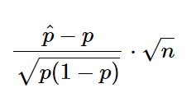
Calculating the Test Statistic
The test statistic is used to decide the outcome of the hypothesis test.
The test statistic is a standardized value calculated from the sample.
The formula for the test statistic (TS) of a population proportion is:
p^−p is the difference between the sample proportion (p^) and the claimed population proportion (p).
n is the sample size.
In our example:
The claimed (H0) population proportion (p) was 0.20
The sample proportion (p^) was 10 out of 40, or: 10/40=0.25
The sample size (n) was 40
So the test statistic (TS) is then:

Slide 97
import scipy.stats as stats import math # Specify the number of occurences (x), the sample size (n), and the proportion claimed in the null-hypothesis (p) x = 10 n = 40 p = 0.2 # Calculate the sample proportion p_hat = x/n # Calculate and print the test statistic print((p_hat-p)/(math.sqrt((p*(1-p))/(n))))

Slide 98
Concluding
There are two main approaches for making the conclusion of a hypothesis test:
The critical value approach compares the test statistic with the critical value of the significance level.
The P-value approach compares the P-value of the test statistic and with the significance level.

Slide 99
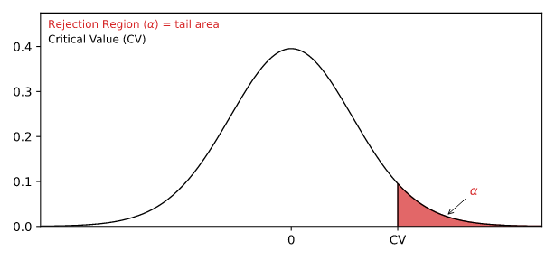
The Critical Value Approach
For the critical value approach we need to find the critical value (CV) of the significance level (α).
For a population proportion test, the critical value (CV) is a Z-value from a standard normal distribution.
This critical Z-value (CV) defines the rejection region for the test.
The rejection region is an area of probability in the tails of the standard normal distribution.
Because the claim is that the population proportion is more than 20%, the rejection region is in the right tail:
The size of the rejection region is decided by the significance level (α).
Choosing a significance level (α) of 0.05, or 5%, we can find the critical Z-value from a Z-table
Note: The functions find the Z-value for an area from the left side.
To find the Z-value for a right tail we need to use the function on the area to the left of the tail (1-0.05 = 0.95).

Slide 100
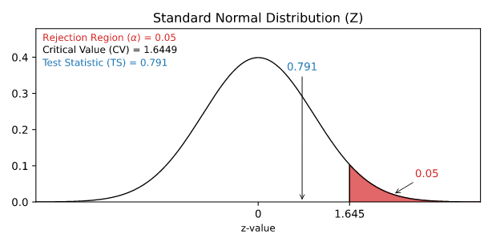
Example
With Python use the Scipy Stats library norm.ppf() function find the Z-value for an = 0.05 in the right tail.
import scipy.stats as stats print(stats.norm.ppf(1-0.05))
we can find that the critical Z-value is 1.6649
For a right tailed test we need to check if the test statistic (TS) is bigger than the critical value (CV).
If the test statistic is bigger than the critical value, the test statistic is in the rejection region.
When the test statistic is in the rejection region, we reject the null hypothesis (H0).
Here, the test statistic (TS) was ≈0.791― and the critical value was 1.6449
Here is an illustration of this test in a graph:

Slide 101
Since the test statistic was smaller than the critical value we do not reject the null hypothesis.
This means that the sample data does not support the alternative hypothesis.
And we can summarize the conclusion stating:
The sample data does not support the claim that "more than 20% of Nobel Prize winners were born in the US" at a 5% significance level.

Slide 102
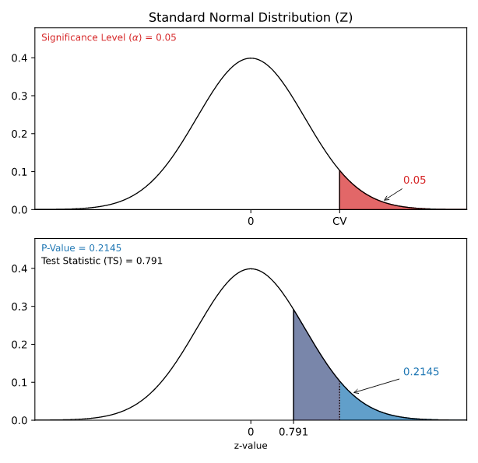
The P-Value Approach
For the P-value approach we need to find the P-value of the test statistic (TS).
If the P-value is smaller than the significance level (α), we reject the null hypothesis (H0).
The test statistic was found to be 0.791
For a population proportion test, the test statistic is a Z-Value from a standard normal distribution.
Because this is a right tailed test, we need to find the P-value of a Z-value bigger than 0.791.
The functions find the P-value (area) to the left side of Z-value.
To find the P-value for a right tail we need to subtract the left area from the total area: 1 - the output of the function.
import scipy.stats as stats print(1-stats.norm.cdf(0.791))
we can find that the P-value is 0.2145
This tells us that the significance level (α) would need to be bigger than 0.2145, or 21.45%, to reject the null hypothesis.
Here is an illustration of this test in a graph:

Slide 103
This P-value is bigger than any of the common significance levels (10%, 5%, 1%).
So the null hypothesis is kept at all of these significance levels.
And we can summarize the conclusion stating:
The sample data does not support the claim that "more than 20% of Nobel Prize winners were born in the US" at a 10%, 5%, or 1% significance level.
Note: It may still be true that the real population proportion is more than 20%.
But there was not strong enough evidence to support it with this sample.

Slide 104
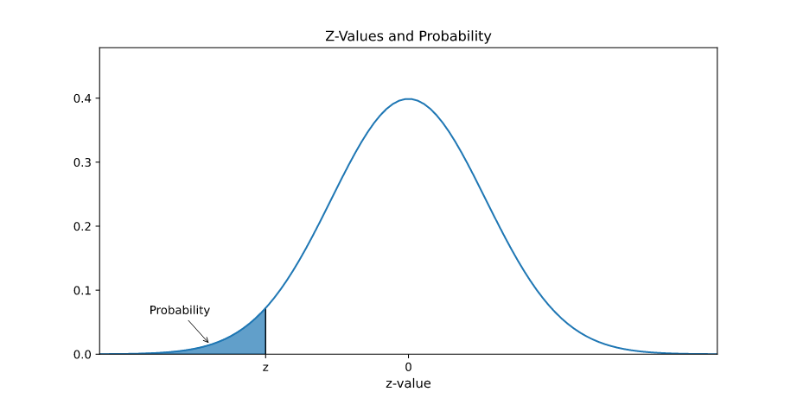
Z-table
The Z-distribution is a standardized normal distribution where the mean is 0 and the standard deviation is 1.
The Z-distribution can be used to find which percent of a population is within a particular number of standard deviations.
Z-Distribution and Table for Negative Z-values
The numbers in the table cells correspond to the area under the graph.
The area under graph is the probability of getting a value that is smaller than z.
The probabilities are decimal values and can be thought of as percentages. For example: 0.1515 is 15.15%.

Slide 105
z .00 .01 .02 .03 .04 .05 .06 .07 .08 .09
-3.4 0.0003 0.0003 0.0003 0.0003 0.0003 0.0003 0.0003 0.0003 0.0003 0.0002
-3.3 0.0005 0.0005 0.0005 0.0004 0.0004 0.0004 0.0004 0.0004 0.0004 0.0003
-3.2 0.0007 0.0007 0.0006 0.0006 0.0006 0.0006 0.0006 0.0005 0.0005 0.0005
-3.1 0.0010 0.0009 0.0009 0.0009 0.0008 0.0008 0.0008 0.0008 0.0007 0.0007
-3.0 0.0013 0.0013 0.0013 0.0012 0.0012 0.0011 0.0011 0.0011 0.0010 0.0010
-2.9 0.0019 0.0018 0.0018 0.0017 0.0016 0.0016 0.0015 0.0015 0.0014 0.0014
-2.8 0.0026 0.0025 0.0024 0.0023 0.0023 0.0022 0.0021 0.0021 0.0020 0.0019
-2.7 0.0035 0.0034 0.0033 0.0032 0.0031 0.0030 0.0029 0.0028 0.0027 0.0026
-2.6 0.0047 0.0045 0.0044 0.0043 0.0041 0.0040 0.0039 0.0038 0.0037 0.0036
-2.5 0.0062 0.0060 0.0059 0.0057 0.0055 0.0054 0.0052 0.0051 0.0049 0.0048
-2.4 0.0082 0.0080 0.0078 0.0075 0.0073 0.0071 0.0069 0.0068 0.0066 0.0064
-2.3 0.0107 0.0104 0.0102 0.0099 0.0096 0.0094 0.0091 0.0089 0.0087 0.0084
-2.2 0.0139 0.0136 0.0132 0.0129 0.0125 0.0122 0.0119 0.0116 0.0113 0.0110
-2.1 0.0179 0.0174 0.0170 0.0166 0.0162 0.0158 0.0154 0.0150 0.0146 0.0143
-2.0 0.0228 0.0222 0.0217 0.0212 0.0207 0.0202 0.0197 0.0192 0.0188 0.0183
-1.9 0.0287 0.0281 0.0274 0.0268 0.0262 0.0256 0.0250 0.0244 0.0239 0.0233
-1.8 0.0359 0.0351 0.0344 0.0336 0.0329 0.0322 0.0314 0.0307 0.0301 0.0294
-1.7 0.0446 0.0436 0.0427 0.0418 0.0409 0.0401 0.0392 0.0384 0.0375 0.0367
-1.6 0.0548 0.0537 0.0526 0.0516 0.0505 0.0495 0.0485 0.0475 0.0465 0.0455
-1.5 0.0668 0.0655 0.0643 0.0630 0.0618 0.0606 0.0594 0.0582 0.0571 0.0559
-1.4 0.0808 0.0793 0.0778 0.0764 0.0749 0.0735 0.0721 0.0708 0.0694 0.0681
-1.3 0.0968 0.0951 0.0934 0.0918 0.0901 0.0885 0.0869 0.0853 0.0838 0.0823
-1.2 0.1151 0.1131 0.1112 0.1093 0.1075 0.1056 0.1038 0.1020 0.1003 0.0985
-1.1 0.1357 0.1335 0.1314 0.1292 0.1271 0.1251 0.1230 0.1210 0.1190 0.1170
-1.0 0.1587 0.1562 0.1539 0.1515 0.1492 0.1469 0.1446 0.1423 0.1401 0.1379
-0.9 0.1841 0.1814 0.1788 0.1762 0.1736 0.1711 0.1685 0.1660 0.1635 0.1611
-0.8 0.2119 0.2090 0.2061 0.2033 0.2005 0.1977 0.1949 0.1922 0.1894 0.1867
-0.7 0.2420 0.2389 0.2358 0.2327 0.2296 0.2266 0.2236 0.2206 0.2177 0.2148
-0.6 0.2743 0.2709 0.2676 0.2643 0.2611 0.2578 0.2546 0.2514 0.2483 0.2451
-0.5 0.3085 0.3050 0.3015 0.2981 0.2946 0.2912 0.2877 0.2843 0.2810 0.2776
-0.4 0.3446 0.3409 0.3372 0.3336 0.3300 0.3264 0.3228 0.3192 0.3156 0.3121
-0.3 0.3821 0.3783 0.3745 0.3707 0.3669 0.3632 0.3594 0.3557 0.3520 0.3483
-0.2 0.4207 0.4168 0.4129 0.4090 0.4052 0.4013 0.3974 0.3936 0.3897 0.3859
-0.1 0.4602 0.4562 0.4522 0.4483 0.4443 0.4404 0.4364 0.4325 0.4286 0.4247
-0.0 0.5000 0.4960 0.4920 0.4880 0.4840 0.4801 0.4761 0.4721 0.4681 0.4641

Slide 106
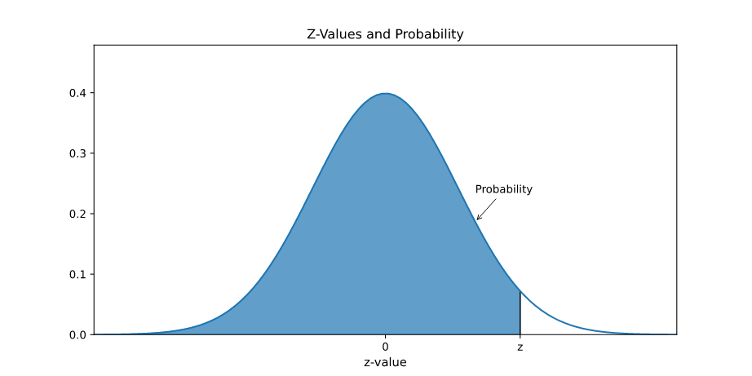
Z-Distribution and Table of Positive Z-Values
The numbers in the table cells correspond to the area under the graph.
The area under graph is the probability of getting a value that is smaller than z.
The probabilities are decimal values and can be thought of as percentages. For example: 0.7088 is 70.88%.

Slide 107
Example of How to Use the Z-Table
The Z-value is found combining the numbers in the first colum and the first row.
For example, the probability for getting a z-value smaller than 1.85 is found by finding the number in the table where the row is 1.8 and the column is 0.05.
So the probability is: 0.9678 is 96.78%.

Slide 108
Hypothesis Testing a Mean
A population mean is an average of value a population.
Hypothesis tests are used to check a claim about the size of that population mean.
For example:
Population: Nobel Prize winners
Category: Age when they received the prize.
And we want to check the claim:
"The average age of Nobel Prize winners when they received the prize is more than 55"
By taking a sample of 30 randomly selected Nobel Prize winners we could find that:
The mean age in the sample (x¯) is 62.1
The standard deviation of age in the sample (s) is 13.46
From this sample data we check the claim with the steps below.

Slide 109
Checking the Conditions
The conditions for calculating a confidence interval for a proportion are:
The sample is randomly selected
And either:
The population data is normally distributed
Sample size is large enough
A moderately large sample size, like 30, is typically large enough.
In the example, the sample size was 30 and it was randomly selected, so the conditions are fulfilled.

Slide 110
Defining the Claims
We need to define a null hypothesis (H0) and an alternative hypothesis (H1) based on the claim we are checking.
The claim was:
"The average age of Nobel Prize winners when they received the prize is more than 55"
In this case, the parameter is the mean age of Nobel Prize winners when they received the prize (μ).
The null and alternative hypothesis are then:
Null hypothesis: The average age was 55.
Alternative hypothesis: The average age was more than 55.
Which can be expressed with symbols as:
H0: μ=55
H1: sigma>55
This is a 'right tailed' test, because the alternative hypothesis claims that the proportion is more than in the null hypothesis.
If the data supports the alternative hypothesis, we reject the null hypothesis and accept the alternative hypothesis.

Slide 111
Deciding the Significance Level
The significance level (α) is the uncertainty we accept when rejecting the null hypothesis in a hypothesis test.
The significance level is a percentage probability of accidentally making the wrong conclusion.
Typical significance levels are:
α=0.1 (10%)
α=0.05 (5%)
α=0.01 (1%)
A lower significance level means that the evidence in the data needs to be stronger to reject the null hypothesis.
There is no "correct" significance level - it only states the uncertainty of the conclusion.

Slide 112

Calculating the Test Statistic
The test statistic is used to decide the outcome of the hypothesis test.
The test statistic is a standardized value calculated from the sample.
The formula for the test statistic (TS) of a population mean is:
x¯−μ is the difference between the sample mean (x¯) and the claimed population mean (μ).
s is the sample standard deviation.
n is the sample size.
In our example:
The claimed (H0) population mean (μ) was 55
The sample mean (x¯) was 62.1
The sample standard deviation (s) was 13.46
The sample size (n) was

Slide 113

So the test statistic (TS) is then:
import scipy.stats as stats import math # Specify the sample mean (x_bar), the sample standard deviation (s), the mean claimed in the null-hypothesis (mu_null), and the sample size (n) x_bar = 62.1 s = 13.46 mu_null = 55 n = 30 # Calculate and print the test statistic print((x_bar - mu_null)/(s/math.sqrt(n)))

Slide 114
Concluding
There are two main approaches for making the conclusion of a hypothesis test:
The critical value approach compares the test statistic with the critical value of the significance level.
The P-value approach compares the P-value of the test statistic and with the significance level.

Slide 115
The Critical Value Approach
For the critical value approach we need to find the critical value (CV) of the significance level (α).
For a population mean test, the critical value (CV) is a T-value from a student's t-distribution.
This critical T-value (CV) defines the rejection region for the test.
The rejection region is an area of probability in the tails of the standard normal distribution.
Because the claim is that the population mean is more than 55, the rejection region is in the right tail:
The size of the rejection region is decided by the significance level (α).
The student's t-distribution is adjusted for the uncertainty from smaller samples.
This adjustment is called degrees of freedom (df), which is the sample size (n)-1
In this case the degrees of freedom (df) is: 30-1=29
Choosing a significance level (α) of 0.01, or 1%, we can find the critical T-value from a T-table
With Python use the Scipy Stats library t.ppf() function find the T-Value for an = 0.01 at 29 degrees of freedom (df).
import scipy.stats as stats print(stats.t.ppf(1-0.01, 29))
we can find that the critical T-Value is 2.462
For a right tailed test we need to check if the test statistic (TS) is bigger than the critical value (CV).
Try it Yourself

Slide 116
If the test statistic is bigger than the critical value, the test statistic is in the rejection region.
When the test statistic is in the rejection region, we reject the null hypothesis (H0).
Here, the test statistic (TS) was ≈2.889― and the critical value was 2.462
Since the test statistic was bigger than the critical value we reject the null hypothesis.
This means that the sample data supports the alternative hypothesis.
This means that the sample data supports the alternative hypothesis.
The sample data supports the claim that "The average age of Nobel Prize winners when they received the prize is more than 55" at a 1% significance level.

Slide 117
The P-Value Approach
For the P-value approach we need to find the P-value of the test statistic (TS).
If the P-value is smaller than the significance level (α), we reject the null hypothesis (H0).
The test statistic was found to be 2.889
For a population proportion test, the test statistic is a T-Value from a student's t-distribution.
Because this is a right tailed test, we need to find the P-value of a t-value bigger than 2.889.
The student's t-distribution is adjusted according to degrees of freedom (df), which is the sample size 30-1=29
With Python use the Scipy Stats library t.cdf() function find the P-value of a T-value bigger than 2.889 at 29 degrees of freedom (df):
import scipy.stats as stats print(1-stats.t.cdf(2.889, 29))
we can find that the P-value is 0.0036
This tells us that the significance level (α) would need to be bigger than 0.0036, or 0.36%, to reject the null hypothesis.

Slide 118
This P-value is smaller than any of the common significance levels (10%, 5%, 1%).
So the null hypothesis is rejected at all of these significance levels.
And we can summarize the conclusion stating:
The sample data supports the claim that "The average age of Nobel Prize winners when they received the prize is more than 55" at a 10%, 5%, or 1% significance level.
Note: An outcome of an hypothesis test that rejects the null hypothesis with a p-value of 0.36% means:
For this p-value, we only expect to reject a true null hypothesis 36 out of 10000 times.

Slide 119
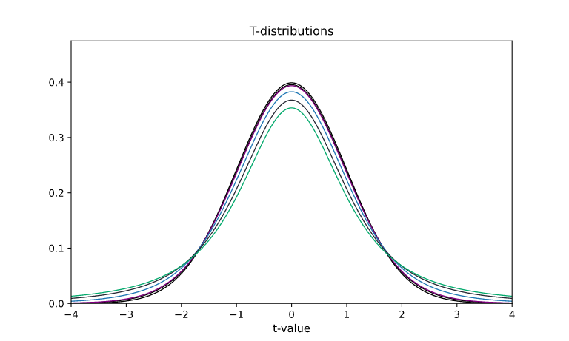
Student's T Distribution
The student's t-distribution is similar to a normal distribution and used in statistical inference to adjust for uncertainty.
The t-distribution is used for estimation and hypothesis testing of a population mean (average).
The t-distribution is adjusted for the extra uncertainty of estimating the mean.
If the sample is small, the t-distribution is wider. If the sample is big, the t-distribtution is narrower.
The bigger the sample size is, the closer the t-distribution gets to the standard normal distribution.

Slide 120
Notice how some of the curves have bigger tails.
This is due to the uncertainty from a smaller sample size.
The green curve has the smallest sample size.
For the t-distribution this is expressed as 'degrees of freedom' (df), which is calculated by subtracting 1 from the sample size (n).
For example a sample size of 30 will make 29 degrees of freedom for the t-distribution.
The t-distribution is used to find critical t-values and p-values (probabilities) for estimation and hypothesis testing.
Finding the P-Value of a T-Value
With Python use the Scipy Stats library t.cdf() function find the probability of getting less than a t-value of 2.1 with 29 degrees of freedom:
import scipy.stats as stats print(stats.t.cdf(2.1, 29))
Finding the T-value of a P-Value
With Python use the Scipy Stats library t.ppf() function find the t-value separating the top 25% from the bottom 75% with 29 degrees of freedom:
import scipy.stats as stats print(stats.t.ppf(0.75, 29))

